Slide 1
IMDB Movie Analysis Ayush Saxena
Ayush Saxena
06-01-2023
1
1

Slide 2
Project Description
In this Project, the data is all about the IMDB movie information, in this data we have columns such as actor names, movie titles, years, and many more. In order to analyze the data, we also have audience ratings and movie reviews. In this project, we will use all this information and extract meaningful insights with the help of excel and complete the statistics conclusion. (Techstack – Microsoft Excel)
Approach
I carefully walk through the raw data and then analyze the data what data is and then I switch my approach that which column has which type of information after that, I walk through the team requirement question and think about it, Then I remove all the null values and duplicate values from the data then I worked on it by applying suitable aggregation.
(Techstack – Microsoft Excel)

Slide 3
Approach
In this Project, the data is all about the IMDB movie information, in this data we have columns such as actor names, movie titles, years, and many more. In order to analyze the data, we also have audience ratings and movie reviews. In this project, we will use all this information and extract meaningful insights with the help of excel and complete the statistics conclusion. (Techstack – Microsoft Excel)
Approach
I carefully walk through the raw data and then analyze the data what data is and then I switch my approach that which column has which type of information after that, I walk through the team requirement question and think about it, Then I remove all the null values and duplicate values from the data then I worked on it by applying suitable aggregation.

Slide 4
A. Cleaning of the data:: This is one of the most important steps to perform before moving forward with the analysis. Use your knowledge learned till now to do this. (Dropping columns, removing null values, etc.) Your task: Clean the data
Removing the null Values By selecting all data then choose the Find and select option then go to special then choose black then click ok by this we have selected the null row then delete the entire row firstly we have 5044 rows but after removing the null values now we the have remaining 3816 rows.

Slide 5
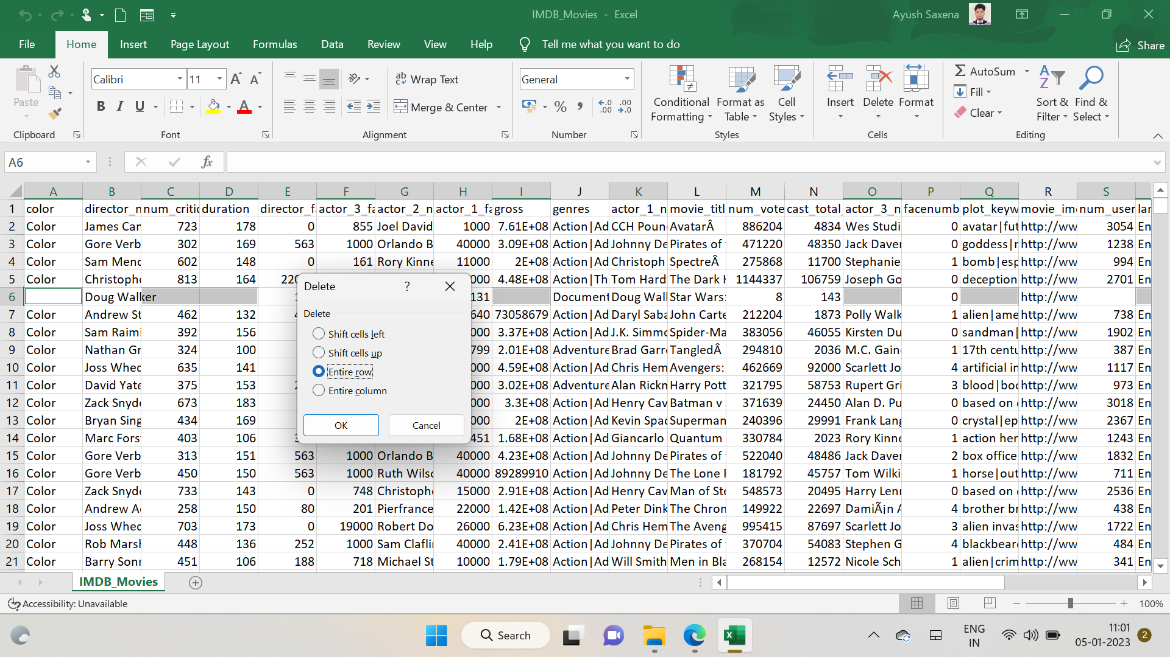
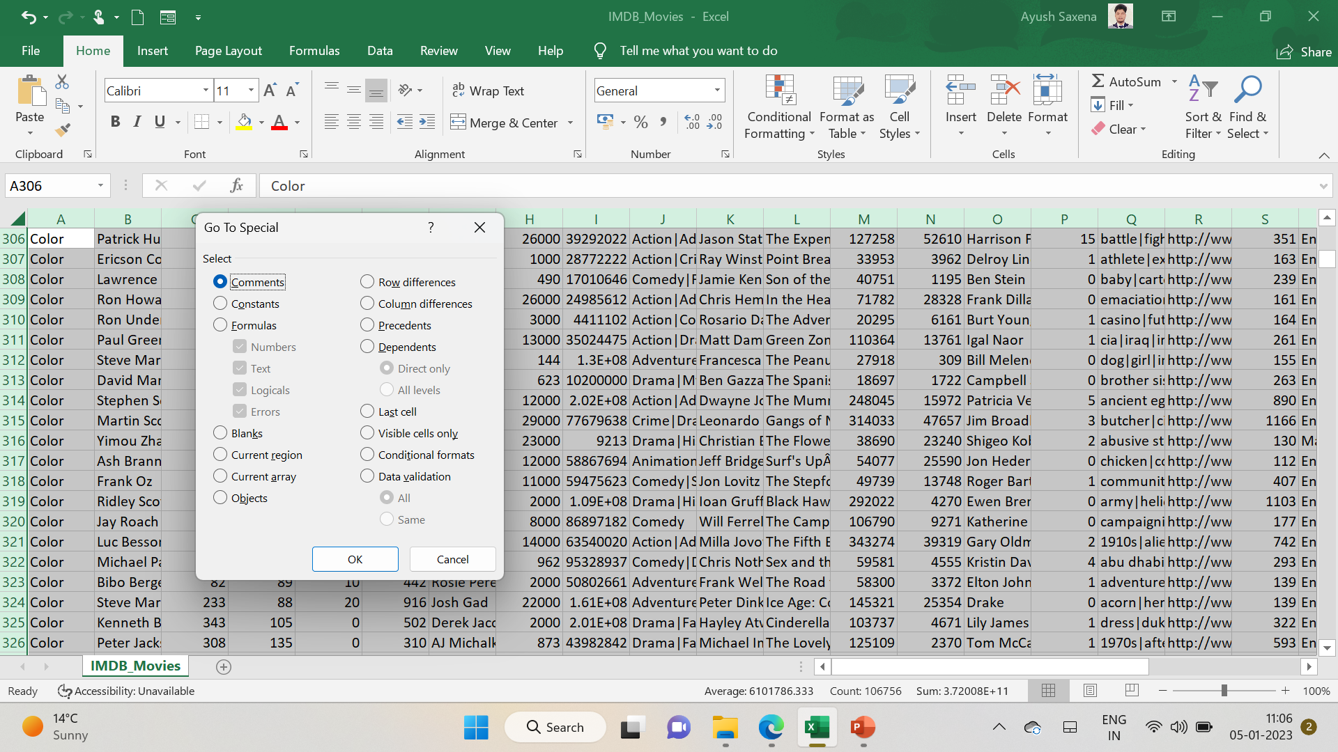

Slide 6
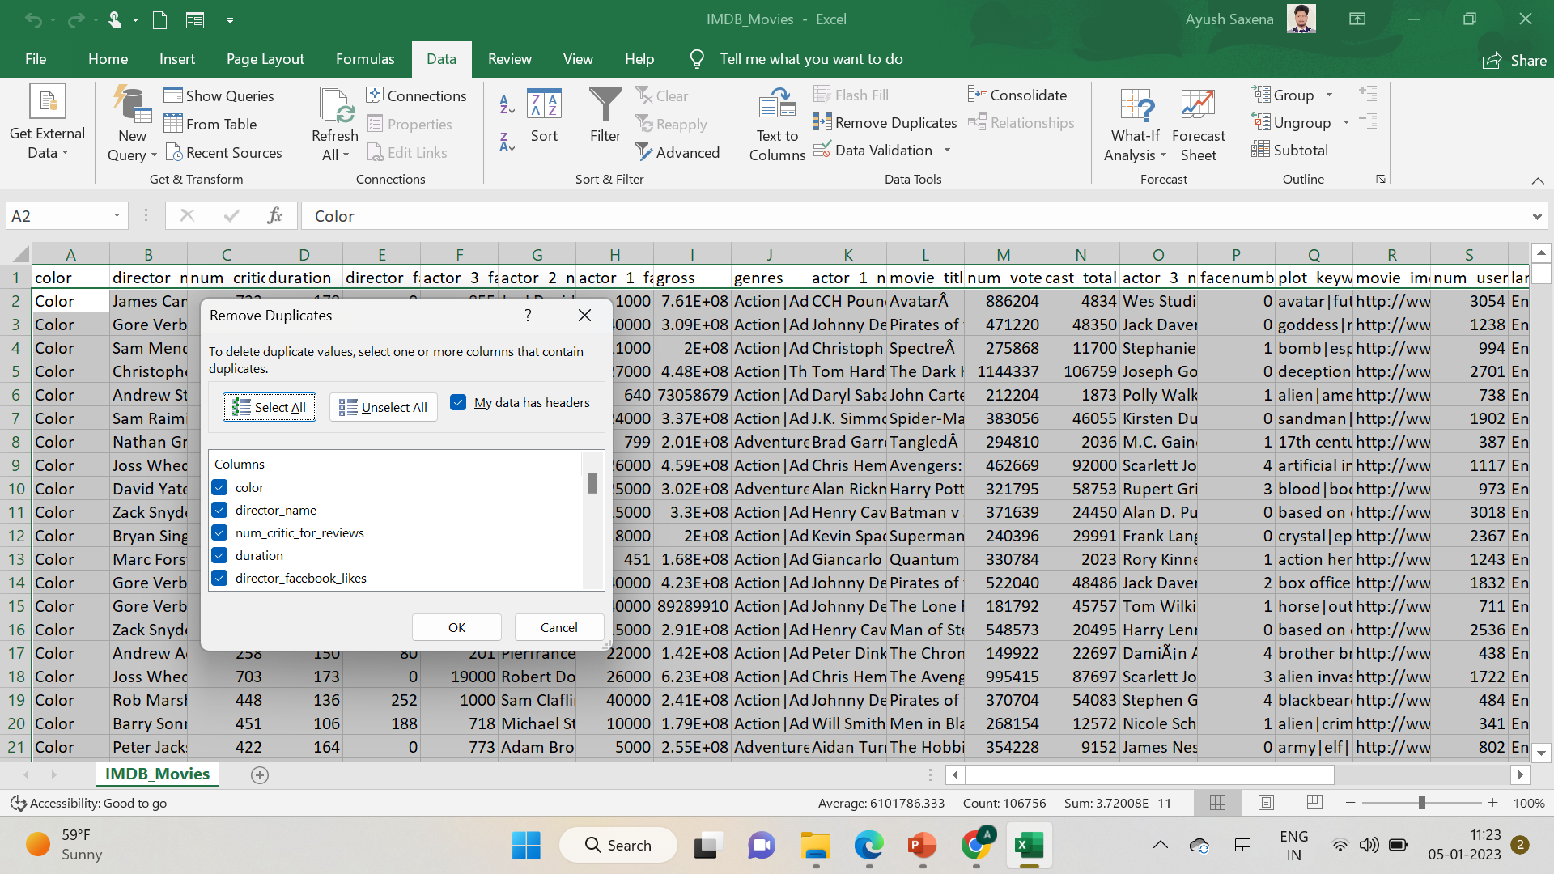
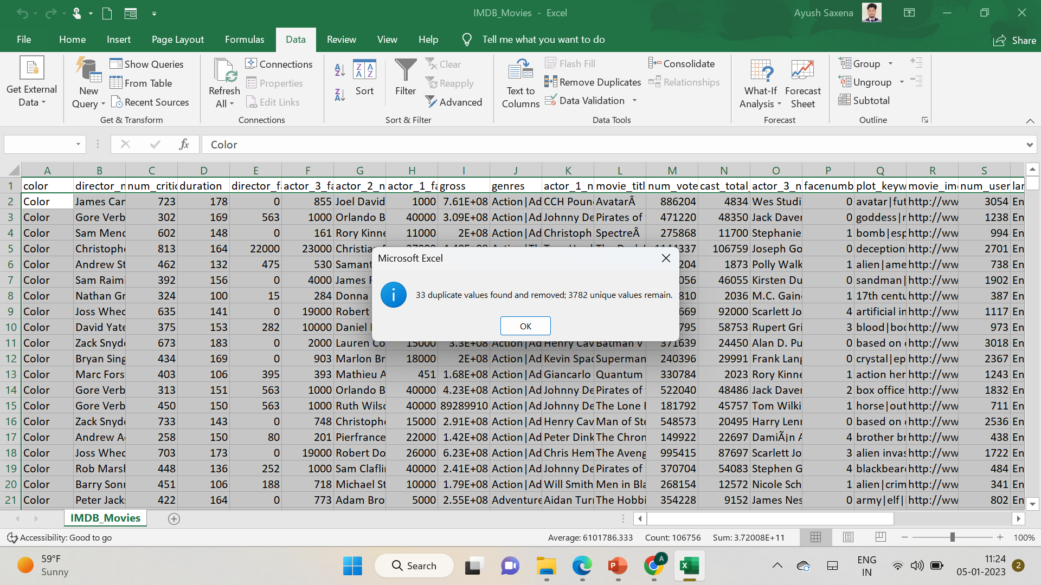
Cleaning of the data Removing the duplicate Values from the table

Slide 7
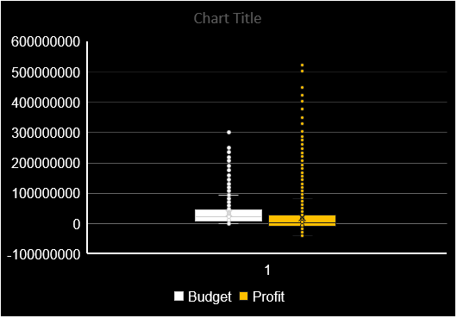
B. Movies with the highest profit: Create a new column called profit which contains the difference between the two columns: gross and budget. Sort the column using the profit column as a reference. Plot profit (y-axis) vs budget (x-axis) and observe the outliers using the appropriate chart type. Your task: Find the movies with the highest profit. Avatar Is the movie with the highest profit

Slide 8
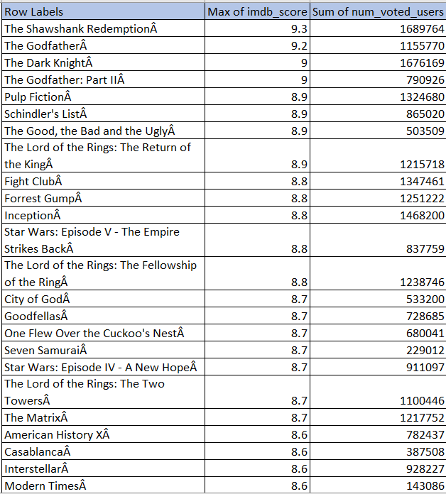
C. Top 250: Create a new column IMDb_Top_250 and store the top 250 movies with the highest IMDb Rating (corresponding to the column: IMDB_score). Also make sure that for all of these movies, the num_voted_users is greater than 25,000. Also, add a Rank column containing the values 1 to 250 indicating the ranks of the corresponding films. Extract all the movies in the IMDb_Top_250 column which are not in the English language and store them in a new column named Top_Foreign_Lang_Film. You can use your own imagination also! Your task: Find IMDB Top 250
And many more rows are there apart from this.

Slide 9
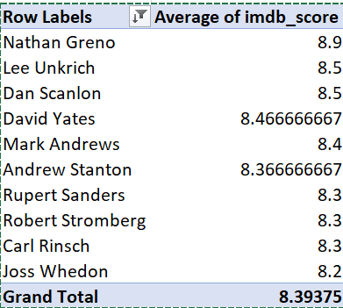
D. Best Directors: Group the column using the director_name column. Find out the top 10 directors for whom the mean of imdb_score is the highest and store them in a new column top10director. In case of a tie in IMDb score between two directors, sort them alphabetically. Your task: Find the best directors

Slide 10
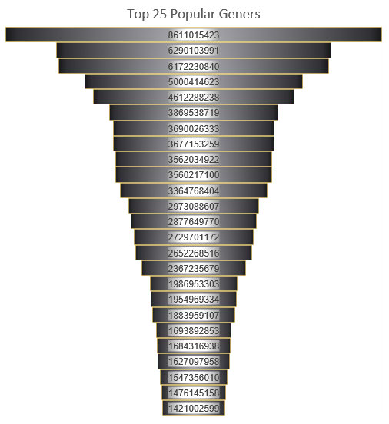
E. Popular Genres: Perform this step using the knowledge gained while performing previous steps. Your task: Find popular genres
Row Labels | Sum of gross
Action|Adventure|Sci-Fi | 8611015423
Comedy|Romance | 6290103991
Comedy | 6172230840
Comedy|Drama|Romance | 5000414623
Action|Adventure|Thriller | 4612288238
Adventure|Animation|Comedy|Family|Fantasy | 3869538719
Drama|Romance | 3690026333
Action|Adventure|Sci-Fi|Thriller | 3677153259
Comedy|Drama | 3562034922
Action|Adventure|Fantasy|Sci-Fi | 3560217100
Action|Adventure|Fantasy | 3364768404
Action|Crime|Thriller | 2973088607
Drama | 2877649770
Crime|Drama|Thriller | 2729701172
Adventure|Animation|Comedy|Family | 2652268516
Adventure|Family|Fantasy | 2367235679
Action|Comedy|Crime | 1986953303
Action|Crime|Drama|Thriller | 1954969334
Comedy|Crime | 1883959107
Horror | 1693892853
Crime|Drama|Mystery|Thriller | 1684316938
Action|Thriller | 1627097958
Adventure|Sci-Fi|Thriller | 1547356010
Action|Sci-Fi | 1476145158
Comedy|Family | 1421002599
Grand Total | 81285428856

Slide 11
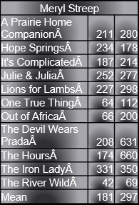
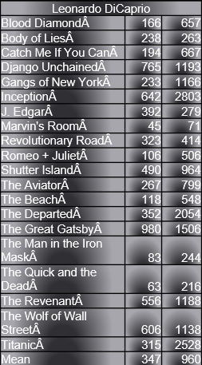
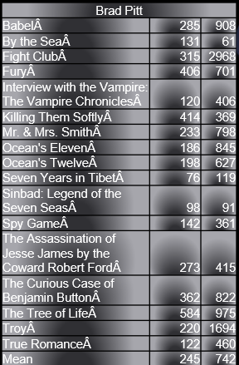
F. Charts: Create three new columns namely, Meryl_Streep, Leo_Caprio, and Brad_Pitt which contain the movies in which the actors: 'Meryl Streep', 'Leonardo DiCaprio', and 'Brad Pitt' are the lead actors. Use only the actor_1_name column for extraction. Also, make sure that you use the names 'Meryl Streep', 'Leonardo DiCaprio', and 'Brad Pitt' for the said extraction. Append the rows of all these columns and store them in a new column named Combined. Group the combined column using the actor_1_name column. Find the mean of the num_critic_for_reviews and num_users_for_review and identify the actors which have the highest mean. Observe the change in the number of voted users over decades using a bar chart. Create a column called decade which represents the decade to which every movie belongs. For example, the title_year year 1923, 1925 should be stored as the 1920s. Sort the column based on the column decade, group it by decade, and find the sum of users who voted in each decade. Store this in a new data frame called df_by_decade. Your task: Find the critic-favorite and audience-favorite actors
Meryl Streep
A Prairie Home CompanionÂ | 211 | 280
Hope SpringsÂ | 234 | 178
It's ComplicatedÂ | 187 | 214
Julie & JuliaÂ | 252 | 277
Lions for LambsÂ | 227 | 298
One True ThingÂ | 64 | 112
Out of AfricaÂ | 66 | 200
The Devil Wears PradaÂ | 208 | 631
The HoursÂ | 174 | 660
The Iron LadyÂ | 331 | 350
The River WildÂ | 42 | 69
Mean | 181 | 297
Leonardo DiCaprio
Blood DiamondÂ | 166 | 657
Body of LiesÂ | 238 | 263
Catch Me If You CanÂ | 194 | 667
Django UnchainedÂ | 765 | 1193
Gangs of New YorkÂ | 233 | 1166
InceptionÂ | 642 | 2803
J. EdgarÂ | 392 | 279
Marvin's RoomÂ | 45 | 71
Revolutionary RoadÂ | 323 | 414
Romeo + JulietÂ | 106 | 506
Shutter IslandÂ | 490 | 964
The AviatorÂ | 267 | 799
The BeachÂ | 118 | 548
The DepartedÂ | 352 | 2054
The Great GatsbyÂ | 980 | 1506
The Man in the Iron MaskÂ | 83 | 244
The Quick and the DeadÂ | 63 | 216
The RevenantÂ | 556 | 1188
The Wolf of Wall StreetÂ | 606 | 1138
TitanicÂ | 315 | 2528
Mean | 347 | 960
Brad Pitt
BabelÂ | 285 | 908
By the SeaÂ | 131 | 61
Fight ClubÂ | 315 | 2968
FuryÂ | 406 | 701
Interview with the Vampire: The Vampire ChroniclesÂ | 120 | 406
Killing Them SoftlyÂ | 414 | 369
Mr. & Mrs. SmithÂ | 233 | 798
Ocean's ElevenÂ | 186 | 845
Ocean's TwelveÂ | 198 | 627
Seven Years in TibetÂ | 76 | 119
Sinbad: Legend of the Seven SeasÂ | 98 | 91
Spy GameÂ | 142 | 361
The Assassination of Jesse James by the Coward Robert FordÂ | 273 | 415
The Curious Case of Benjamin ButtonÂ | 362 | 822
The Tree of LifeÂ | 584 | 975
TroyÂ | 220 | 1694
True RomanceÂ | 122 | 460
Mean | 245 | 742
Leonardo Dicaprio has the Highest Mean among the above three across

Slide 12
Row Labels | Sum of num_voted_users
1920-1929 | 116387
1930-1939 | 804839
1940-1949 | 636002
1950-1959 | 678336
1960-1969 | 3120472
1970-1979 | 8696534
1980-1989 | 19987716
1990-1999 | 69582304
2000-2009 | 170760756
2010-2019 | 119573207
Grand Total | 393956553
Up to the 2000 decade number of reviews from users gradually increase and in the 2000 decade highest reviews were recorded but after that number of reviews from users decreased

Slide 13
Results
As a result, we successfully extracted meaningful data and some of the important questions as we learned about the cleaning of data and drawing some graphs, This project helped me a lot to enhance my excel knowledge and implementation of various graphs on data.

Slide 14
Thank You

